Slide 1
Agile Scrum methodologies

Slide 2
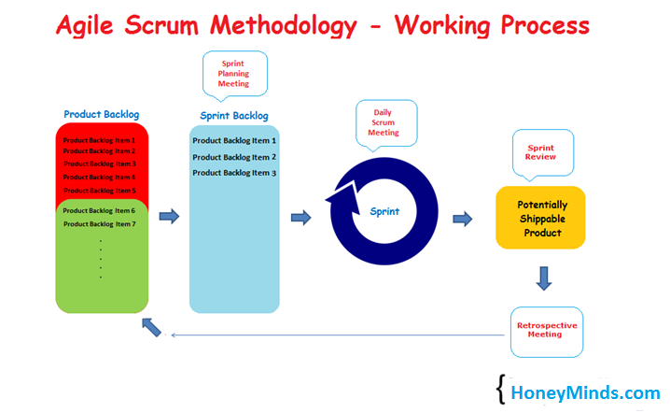
Agile Scrum Methodology
Agile Scrum Methodology is one of the popular Agile software development methods. There are some other agile software development methods but the popular one which is using widely is Agile Scrum Methodology. The Agile Scrum Methodology is a combination of both Incremental and Iterative model for managing product development.

Slide 3
What is Sprint?
Sprint: Each Sprint has a specified timeline (2 weeks to 1 month). This timeline will be agreed by a Scrum Team during the Sprint Planning Meeting. Here, User Stories are split into different modules. Result of every Sprint should be potentially shippable product.
The three important aspects involved in Scrum such as Roles, Artifacts and Meetings

Slide 4
ROLES IN AGILE SCRUM METHODOLOGY
Product Owner:
Product Owner usually represents the Client and acts as a point of contact from Client side. The one who prioritizes the list of Product Backlogs which Scrum Team should finish and release.
Scrum Master:
Scrum Master acts as a facilitator to the Scrum Development Team. An effective scrum master deeply understands the work being done by the team and can help the team optimize their transparency and delivery flow. As the facilitator-in-chief, he/she schedules the needed resources (both human and logistical) for sprint planning, stand-up, sprint review, and the sprint retrospective.
Scrum Development Team:
Developer’s, QA’s. Who develops the product? Scrum development team decides the effort estimation to complete a Product Backlog Item.
Scrum Team:
A cross-functional, self-organizing group of dedicated people (Group of Product Owner, Business Analyst, Developer’s and QA’s). Recommended size of a scrum team is 7 plus or minus 2 (i.e., between 5 to 9 members in a team)

Slide 5
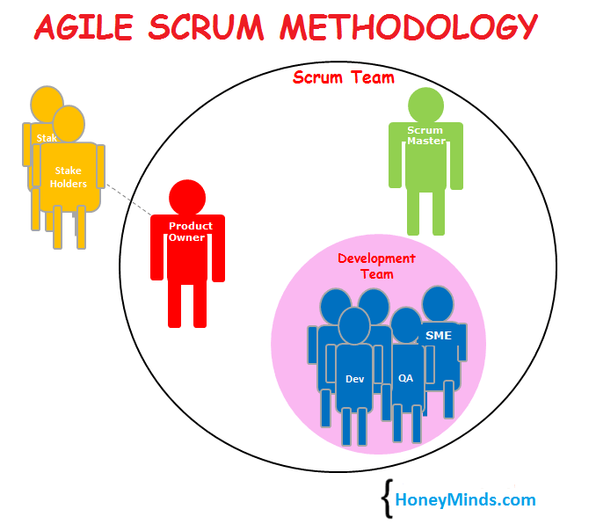
Agile scrum methodology

Slide 6
ARTIFACTS IN AGILE SCRUM METHODOLOGY:
User Stories: User Stories are not like a traditional requirement documents. In User Stories, stakeholder mention what features they need and what they want to achieve.
Product Backlog: Product Backlog is a repository where the list of Product Backlog Items stored and maintained by the Product Owner. The lists of Product Backlog Items are prioritized by the Product Owner as high and low and also could re-prioritize the product backlog constantly.
Sprint Backlog: Group of user stories which scrum development team agreed to do during the current sprint (Committed Product Backlog items)
Product Burn down Chart: A graph which shows how many Product Backlog Items (User Stories) implemented/not implemented.
Sprint Burn down Chart: A graph which shows how many Sprints implemented/not implemented by Scrum Team.
Release Burn down Chart: A graph which shows List of releases still pending, which Scrum Team have planned
Defect Burn down Chart: A graph which shows how many defects identified and fixed.
Note: Burn Down Charts provide proof that the project is on track or not.

Slide 7
MEETINGS IN AGILE SCRUM METHODOLOGY:
Sprint Planning Meeting:
The first step of Scrum is Sprint Planning Meeting where the entire Scrum Team attends. Here the Product Owner selects the Product Backlog Items (User Stories) from the Product Backlog. Most important User Stories at the top of the list and least important User Stories at the bottom. Scrum Development Team decides and provides the effort estimation.
Daily Scrum Meeting: (Daily Stand-up)
Daily Scrum is also known as Daily Stand-up meeting. Here each team member reports to the peer team member on what he/she did yesterday, what he/she going to do today and what obstacles are impeding in their progress. Reporting will be between peers not to Scrum Master or Product Owner. Daily Scrum will be approximately 15mins.
Sprint Review Meeting:
In the Sprint Review Meeting, Scrum Development Team presents a demonstration of a potentially shippable product. Product Owner declares which items are completed and not completed. Product Owner adds the additional items to the product backlog based on the stakeholder’s feedback.
Sprint Retrospective Meeting:
Scrum Team meets again after the Sprint Review Meeting and documents the lessons learnt in the earlier sprint such as “What went well”, “What could be improved”. It helps the Scrum Team to avoid the mistakes in the next Sprints.

Slide 8
When do we use Agile Scrum Methodology?
The client is not so clear on requirements. The client expects quick releases. The client doesn’t give all the requirements at a time.
Conclusion:
In an Agile Scrum Methodology, all the members in a Scrum Team gathers and finalize the Product Backlog Items (User Stories) for a Sprint and commits timeline to release the product. Based on the Daily Scrum meetings, Scrum Development Team develops and tests the product and presents to the Product Owner on Sprint Review Meeting. If the Product Owner accepts all the developed User Stories, then the Sprint is completed, and the Scrum Team goes for the next Sprint in a same manner.

